Slide 1
FOOD AND ENERGY PRICES:
TRUTH AND CONSEQUENCES
Michael Drury
Chief Economist, McVean Trading & Investments, LLC
Economic Forecasting Conference
Atlanta, Ga
May 25, 2011

Slide 2
China’s Share of World Commodity Consumption
Commodity | China % of World
Cement | 53.2%
Iron Ore | 47.7%
Coal | 46.9%
Pigs | 46.4%
Steel | 45.4%
Lead | 44.6%
Zinc | 41.3%
Aluminum | 40.6%
Copper | 38.9%
Eggs | 37.2%
Nickel | 36.3%
Rice | 28.1%
Soybeans | 24.6%
Wheat | 16.6%
Chickens | 15.6%
PPP GDP | 13.6%
Oil | 10.3%
Cattle | 9.5%
GDP | 9.4%
Source: Barclays 2010

Slide 3
WTI vs Brent Crude Oil

Slide 4
Gasoline

Slide 5
Corn

Slide 6
US CORN ENDING STOCKS

Slide 7
Gasoline (Wholesale) vs Corn

Slide 8
Corn / Wheat

Slide 9
Corn / Soybeans

Slide 10
Ethanol Production as a percent of US CORN CROP

Slide 11
US CORN DOMESTIC DISAPPEARANCE

Slide 12
US PLANTED ACRES

Slide 13
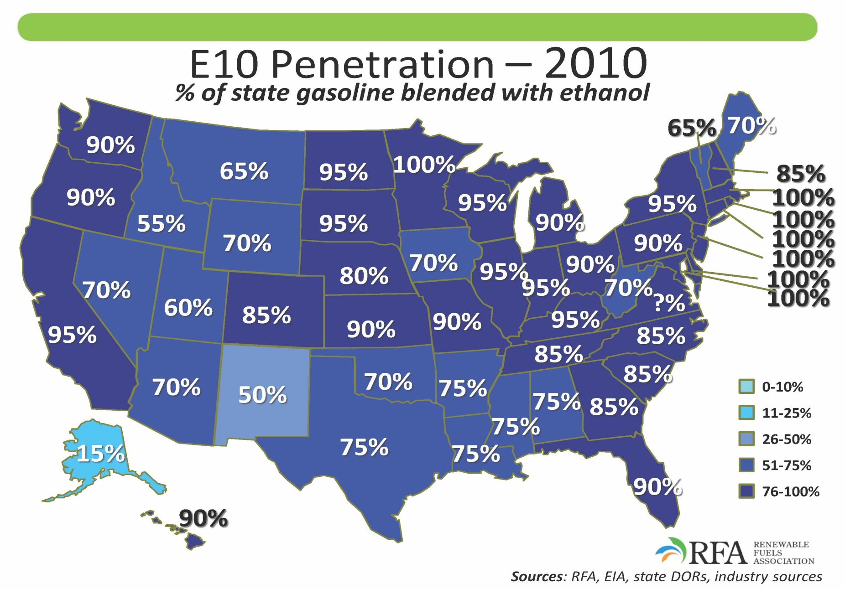
E10 Penetration – 2010 % of state gasoline blended with ethanol

Slide 14
Ethanol Margins, Calculated From Board Values Variable Costs are Covered at 20-40 Cents

Slide 15
Ethanol, Gasoline and Crude Oil Board Curves

Slide 16
Global Stocks-To-Use Ratio

Slide 17
World Corn Stocks

Slide 18
Chinese Corn Stocks

Slide 19
Chinese Spot Cash Grain Prices

Slide 20
CORN BALANCE SHEET
 |  |  |  |  |  |  |  | ALT #1 | ALT #2
 | 06/07 | 07/08 | 08/09 | 09/10 | 10/11 | 11/12 |  | 11/12 | 11/12
Planted Acres (mil.) | 78.3 | 93.5 | 86.0 | 86.4 | 88.2 | 93.2 |  | 93.2 | 93.2
Harvested Acres (mil.) | 70.6 | 86.5 | 78.6 | 79.5 | 81.4 | 85.5 |  | 83.9 | 85.7
% Harvested | 90% | 93% | 91% | 92% | 92% | 92% |  | 90% | 92%
Yield (Bu / acre) | 149.1 | 150.7 | 153.9 | 164.7 | 152.8 | 161.5 |  | 154.2 | 151.6
Production | 10.526 | 13.036 | 12.097 | 13.094 | 12.438 | 13.808 |  | 12.938 | 13.001
Ethanol use | 2.119 | 3.049 | 3.709 | 4.568 | 4.975 | 5.075 |  | 5.075 | 5.075
Ethanol as % of crop | 20% | 23% | 31% | 35% | 40% | 37% |  | 39% | 39%
Non-Ethanol production | 8.407 | 9.987 | 8.388 | 8.526 | 7.463 | 8.733 |  | 7.863 | 7.926
Ending stocks | 1.967 | 1.304 | 1.624 | 1.673 | 1.708 | 0.696 |  | 0.696 | 0.696
Stocks as % of total production | 19% | 10% | 13% | 13% | 14% | 5%
Non-ethanol supply | 10.374 | 11.291 | 10.012 | 10.199 | 9.171 | 9.429 |  | 8.559 | 8.622
Non-ethanol use | 9.070 | 9.667 | 8.339 | 8.491 | 8.475 | 8.575 |  | 8.575 | 8.575
Ending Stocks | 1.304 | 1.624 | 1.673 | 1.708 | 0.696 | 0.854 |  | -0.016 | 0.047
Source: McVean Trading , USDA

Slide 21
Minnesota Spring Wheat Price

Slide 22
U.S. Domestic Meat Availability of Beef (Boneless Equivalent)
Source: USDA

Slide 23
Monthly Kansas Slaughter Steer Price
Source: USDA

Slide 24
U.S. Domestic Meat Availability of Pork (Boneless Equivalent)
Source: USDA

Slide 25
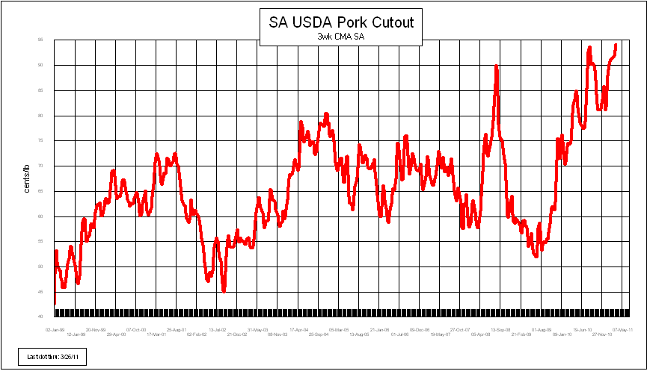
USDA Pork Cutout
Source: USDA

Slide 26
U.S. Domestic Meat Availability of Broilers (Boneless Equivalent)
Source: USDA & McVean Estimate

Slide 27
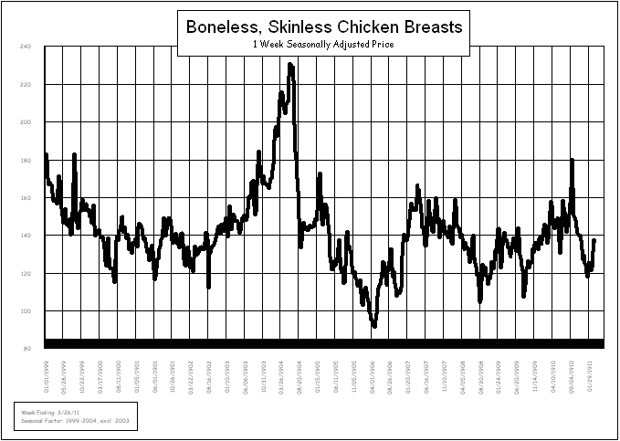
Source: USDA

