Slide 1


May 18, 2011
U.S. Lodging Industry Overview
Prepared for:
Economic Forecasting Center
Georgia State University
by
R. Mark Woodworth
PKF Hospitality Research
Expensive Oil:
A Detour on the Road to Recovery?
or
A Bump on the Path to Better Times?
Accelerating success.
Notes:
*Important* Please choose only one of these first four slides for the title slide of the presentation.

Slide 2
Questions We Have Been Asking:
How many of you believe that hotel owners will make more money this year than last?
Notes:
2

Slide 3
Answer:
Demand, Occupancy, Average Daily Rate, RevPAR and Profits will all be higher in 2011 than they were in 2010*
* Last said in 2006.
Notes:
3

Slide 4
Questions We Have Been Asking:
How about more money in 2012 than in 2011?
Notes:
4

Slide 5
The Hotel Market Cycle
Moving Along the Road to Recovery
Rapid Development
Rapid Development
Lodging Decline, Leads Other Sectors
Development
Picks Up
Equilibrium ADR
2013-2014
U.S. and Atlanta are Here
Long Run
Occupancy
2011-2012
May 2010
ADR and Margins Recover
Occupancy Declines, ADR Follows
Development Slows
Occupancy Recovers
Development at Minimum Levels
Lodging Recovers, Lags Other Sectors
Notes:
5

Slide 6
Economic Assumptions Driving Our Forecasts:
Base Case Scenario
 | Payroll Employment |  | Real Personal Income |  | Real GDP |  | CPI (Inflation)
2009 | -4.3% | -4.3% | -1.9% | -1.9% | -2.6% | -2.6% | -0.3% | -0.3%
2010 | -0.5% | -0.5% | 1.3% | 1.3% | 2.9% | 2.9% | 1.6% | 1.6%
2011 | 1.2% | 1.7% | 3.7% | 4.0% | 3.3% | 3.9% | 2.1% | 1.5%
2012 | 2.3% | 2.4% | 4.7% | 3.8% | 4.3% | 4.0% | 2.0% | 2.5%
2013 | 2.6% | 2.5% | 5.0% | 4.6% | 3.9% | 3.7% | 2.9% | 3.2%
L.R.A. | 1.2% |  | 2.7% |  | 2.7% |  | 2.9%
Source: Moody’s Analytics, April 2011 L.R.A. = Long Run Average
(January 2011)
Updated 9/17/2010 - aw
Notes:
Key among the several variables that factor into the models that support our forecasting efforts are the four measures shown here. According to Moody’s, GDP will experience a modest uptick this year, and all measures should show favorable trends in 2011 and 2012. Growing levels of lodging demand will reappear as a result.
6

Slide 7
A Review of the Drivers of Demand Change
Demand = f (Income, Employment ∆, ADR)
Real Personal Income (RPI)
- Sluggish but not the problem or solution
Employment ∆- Who lost their jobs?
ADR – Plunged!

Slide 8
4-Quarter Moving Average – U.S. All
Total Payroll Employment Change,
Average Daily Room Night Demand
Forecast
Source: Colliers PKF Hospitality Research, Moody’s Analytics, Smith Travel Research

Slide 9

Happy Thoughts
History:
- # of Consecutive Quarters of Increases
∆ Demand – 5 Quarters
∆ Occupancy – 5 Quarters
∆ ADR – 4 Quarters
∆ RevPAR – 4 Quarters
Forecast (Base Case Scenario):
- # of Consecutive Quarters above (below) Long Run Average
∆ Demand (1.5%) – 11 Quarters
∆ (Supply) (2.2%) – 14 Quarters
∆ ADR (2.9%) – 19 Quarters (as far as we can see)
∆ RevPAR (2.3%) – 19 Quarters (ditto)

Slide 10
National Horizon
- Forecasts through 2012
Base Case Scenario
 | Long Term Average | 2006 | 2007 | 2008 | 2009 | 2010 | 2011F | 2012F
Supply | 2.2% | 0.2% | 1.3% | 2.5% | 3.0% | 1.9% | 0.4% | 0.5%
Demand | 1.5% | 0.5% | 0.7% | -2.5% | -6.1% | 7.7% | 5.2% | 5.3%
Occupancy | 62.2% | 63.1% | 62.8% | 59.8% | 54.5% | 57.6% | 60.3% | 63.2%
ADR | 2.9% | 7.6% | 6.4% | 2.9% | -8.5% | -0.2% | 2.6% | 5.8%
RevPAR | 2.3% | 7.9% | 5.9% | -2.1% | -16.6% | 5.4% | 6.8% | 7.6%
Severe Rate Discounting Set the Stage
And a Quicker Demand Turnaround
For a Record Decline
Surpasses Long Run Average
Source: PKF Hospitality Research – June-August 2011Horizons® Report (preliminary), Smith Travel Research
10
Notes:
Looking further ahead, demand growth will increase at a level above the STR long run average this year and will accelerate in 2011 and beyond. Supply growth will be benign well into 2013, although occupancy levels will still be well below their 62.6 % historical average.
Because of the weak occupancy level, room rate recovery will be protracted. RevPAR contraction will end this year, growth will return in 2011, and strong increases should be sustained for several years beginning in 2012.
10

Slide 11
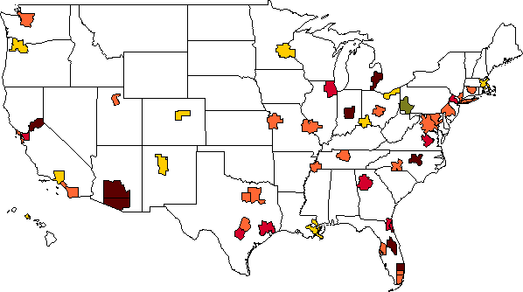

Nominal RevPAR Levels Return to Historical Maximum in Year…
The map below displays the year in which nominal RevPAR levels are forecast to once again achieve their historical maximum: 1 market in 2010, 0 in 2011, 10 markets in 2012, 23 markets in 2013, 8 markets in 2014, and 8 markets in 2015 or later.
Already There
2011
2012
2013
2014
2015 & Beyond
11
Source: Colliers PKF Hospitality Research – March - May 2011 Hotel Horizons® Report, Smith Travel Research
Notes:
The map below displays the year in which nominal RevPAR levels are forecast to once again achieve their historical maximum: 0 markets in 2010 and 2011, 11 markets in 2012, 23 markets in 2013, and 16 markets in 2014 or later.

Slide 12
U.S. Hotel Markets Greatest and Least Change in RevPAR
Forecast Change 2010 to 2011
(6.8)%
Preliminary Update
Source: Colliers PKF Hospitality Research, March - May 2011 Hotel Horizons® report.
12
Notes:
12

Slide 13
2011 RevPAR Forecast By Chain-Scale
Forecast Change 2010 to 2011
Source: PKF Hospitality Research, March – May 2011 Hotel Horizons® report.
13
Notes:
13

Slide 14
Annual Change – All U.S. Hotels Unit-Level NOI*
Base Case Scenario
+64.6% - 1943
+10.4% - 2011F
+13.5% - 2012F
-19.4% - 2001
-22.4% - 1938
-35.4% - 2009
Note: * Before deductions for capital reserve, rent, interest, income taxes, depreciation, and amortization.
Source: PKF Hospitality Research, Trends® in the Hotel Industry sample.
Notes:
14

Slide 15
No Margin for Error in Global Oil Markets…
OPEC spare capacity as a % of global oil demand
Sources: OPEC, EIA, IEA, Moody’s Analytics

Slide 16
Moody’s Oil Price Scenarios
Moody’s approximates the fundamental price of oil at $93.53 in 2011.
Source: Moody’s Analytics

Slide 17
Potential Effect of an Oil Price Spike on U.S GDP
“Every $1 increase in the price of crude oil raises gasoline prices by 2.2 cents per gallon and costs consumers about $3 billion over the course of a year.” - Moody’s Analytics

Slide 18
Potential effect of Oil Price Increases on RevPAR
Long Run Average per STR = 2.3%

Slide 19
Cumulative Change in RevPAR 2010 – 2012 – By Location
Location
Resort and Suburban Locations take the Big Hit
Percent Change in RevPAR
Source: PKF Hospitality Research
Base Case Scenario
Oil at $150 Scenario

Slide 20
Summary Estimates
 | Base Case |  |  | Oil at $125 |  |  | Oil at $150
Year | 2011 | 2012 |  | 2011 | 2012 |  | 2011 | 2012
Occupancy | 60.3% | 63.2% |  | 59.7% | 61.6% |  | 59.2% | 60.2%
ADR | 2.6% | 5.8% |  | 2.1% | 1.3% |  | 2.4% | 0.1%
RevPAR | 6.8% | 7.6% |  | 5.7% | 4.6% |  | 5.2% | 1.8%
NOI | 10.4% | 13.5% |  | 6.5% | 1.9% |  | 6.2% | -2.2%
Source: PKF Hospitality Research – June-August 2011Horizons® Report (preliminary), Smith Travel Research
20
Notes:
Looking further ahead, demand growth will increase at a level above the STR long run average this year and will accelerate in 2011 and beyond. Supply growth will be benign well into 2013, although occupancy levels will still be well below their 62.6 % historical average.
Because of the weak occupancy level, room rate recovery will be protracted. RevPAR contraction will end this year, growth will return in 2011, and strong increases should be sustained for several years beginning in 2012.
20

Slide 21
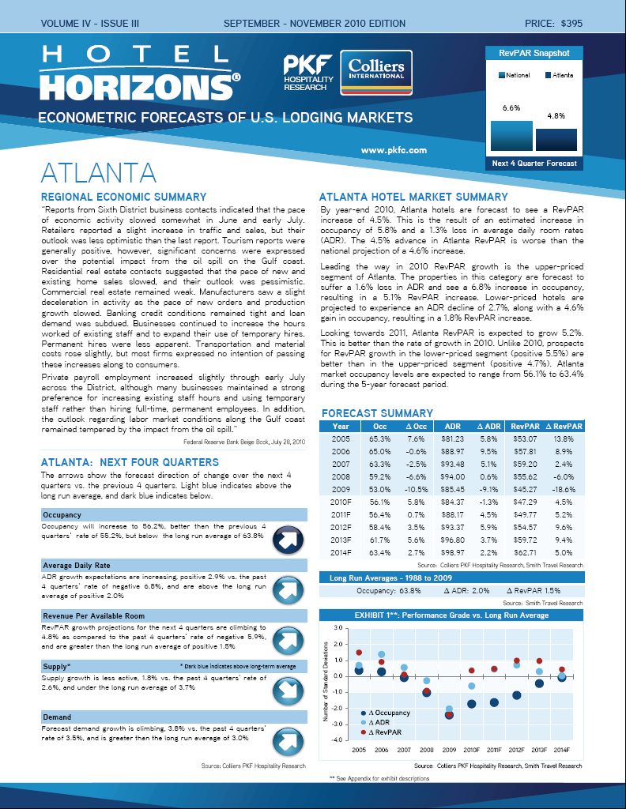
Atlanta Forecasts Come from Hotel Horizons ®

Slide 22
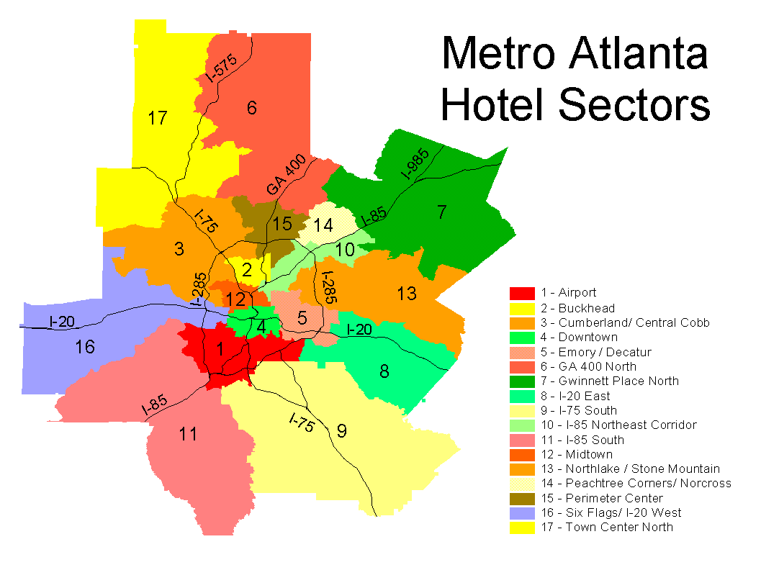
Notes:
17 distinct lodging sectors are tracked.

Slide 23
4-Quarter Moving Average
Total Atlanta Employment and
Total Atlanta Hospitality Employment
1990 – 2010 2011-2015
Total: + 1.8% 2.7%
Hospitality: + 2.3% 3.8%
Forecast
Source: PKF Hospitality Research, Moody’s Analytics

Slide 24
Atlanta Projects Under Construction
City Sectors | # Projects | # Rooms
Airport | 1 | 120
I-75 South | 2 | 181
Six Flags I-20 West | 1 | 100
 | 4 | 401
Long Run Average = 3.24% per year
0.4% of Existing Supply
Source: Dodge / TWR / STR

Slide 25
Representative Brands Upper and Lower Tiers
Upper-Priced | Lower-Priced
Courtyard by Marriott Holiday Inn Hyatt Loews Marriott Hotels Ritz-Carlton | Days Inn Fairfield Inn Hampton Inn Holiday Inn Express Microtel TownPlace Suites
Source: Smith Travel Research
25

Slide 26
Atlanta MSA All Hotels Improved Occupancy in 2010 = Better ADR Performance in 2011
 | 2007 | 2008 | 2009 | 2010 | 2011F | Long-Term Average
Occupancy | 63.4% | 59.2% | 53.0% | 58.0% | 58.2% | 63.2%
% Change | -2.5% | -6.6% | -10.5% | +9.3% | +0.4% | -
ADR | $93.44 | $93.95 | $85.45 | $84.85 | $88.53 | -
% Change | +5.2% | +0.5% | -9.0% | -0.7% | +4.3% | +2.0%
RevPAR | $59.25 | $55.65 | $45.30 | $49.18 | $51.51 | -
% Change | +2.6% | -6.1% | -18.6% | +8.6% | +4.7% | +1.7%
Source: PKF Hospitality Research –March-May 2011 Hotel Horizons® Report, Smith Travel Research

Slide 27
Atlanta MSA Upper-Priced Hotels
 | 2007 | 2008 | 2009 | 2010 | 2011F | Long-Term Average
Occupancy | 65.3% | 61.6% | 55.9% | 61.8% | 61.9% | 66.8%
% Change | -1.8% | -5.6% | -9.4% | +10.7% | 0.2% | -
ADR | $125.25 | $124.56 | $111.47 | $110.81 | $115.79 | -
% Change | 5.2% | -0.6% | -10.5% | -0.6% | 4.5% | +2.1%
RevPAR | $81.75 | $76.78 | $62.26 | $68.52 | $71.72 | -
% Change | 3.2% | -6.1% | -18.9% | +10.1% | 4.7% | +2.6%
Source: PKF Hospitality Research –March-May 2011 Hotel Horizons® Report, Smith Travel Research

Slide 28
Atlanta MSA Lower-Priced Hotels
 | 2007 | 2008 | 2009 | 2010 | 2011F | Long-Term Average
Occupancy | 61.7% | 57.0% | 50.3% | 54.1% | 54.4% | 60.7%
% Change | -3.0% | -7.6% | -11.7% | +7.7% | 0.5% | -
ADR | $61.77 | $62.60 | $57.64 | $55.68 | $57.35 | -
% Change | 5.9% | 1.3% | -7.9% | -3.4% | 3.0% | +1.9%
RevPAR | $38.08 | $35.66 | $28.98 | $30.14 | $31.21 | -
% Change | 2.7% | -6.4% | -18.7% | +4.0% | 3.5% | +1.5%
Source: PKF Hospitality Research –March-May 2011 Hotel Horizons® Report, Smith Travel Research

Slide 29
Summary
No Tailwinds Yet:
* Persistent high levels of unemployment
* Continued weakness in housing
* Higher inflation lifts appeal of hotels
* Oil prices – a Bump on the Path.
Notes:
29
Read above.

Slide 30

Thank you for your time.
30

